Slide 1
Unit 3

Slide 2
Pert Cost Control
Cost reduction by crashing of activity
Resource Scheduling
Resource Levelling

Slide 3
PERT/Cost
assists in planning and controlling program cost expenditures by employing several cost-estimating techniques as monitors to determine variances, i.e., where actual costs are different from planned costs.
Developed by DoD and NASA
a) assist project managers by assigning costs to the working levels of projects in the detail needed for planning schedules and costs,
b) evaluate schedule and cost performance, and
c) predict and control costs during the project’s operational phases

Slide 4
PERT/Cost
PERT Cost Activity Cost Estimates
1) a single cost estimate of expected actual cost,
2) three cost estimates combined by formula into an expected cost (similar to determining expected time in PERT Time),
3) optimum time-cost curves (used in conjunction with the Resource Allocation Procedure supplement), and
4) three separate cost estimates (used in conjunction with the Time-Cost Option Procedure supplement).

Slide 5
PERT/Cost
Single Cost Estimate: A single cost estimate of activity is based upon the sum of cost elements within each activity.
These estimates are made by determining manpower, material, and other resources required to complete each activity.
Direct and indirect cost

Slide 6
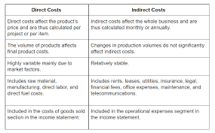
PERT/Cost

Slide 7
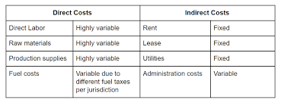
PERT/Cost

Slide 8
PERT/Cost
Three Cost Estimate: The three cost estimate approach has as its goal determining an “expected activity cost.”
subject to probability analysis.
Ce = (Ca + 4Cm+Cb)/6
if the cost estimates are realistic, the probabilities of achieving the expected cost can be used for project contract negotiations.

Slide 9
PERT/Cost
Optimum Time-Cost Curve Estimate:
this concept is differential costing with time
The intention of this approach is to optimize project time and costs by using optimum estimated activity costs
It assumes the existence of a direct relationship between time and costs for each network activity.

Slide 10
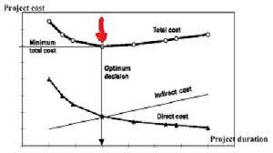
PERT/Cost

Slide 11
PERT/Cost
Resource Allocation Supplement:
This supplement is composed of a variation of continuous time-cost curves which can be used to plan and control a group of important activities representing only a minor portion of a project network.

Slide 12
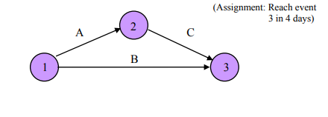
PERT/Cost
Procedure of RAS :
Step 1: Construct network of activities in which you are interested.

Slide 13
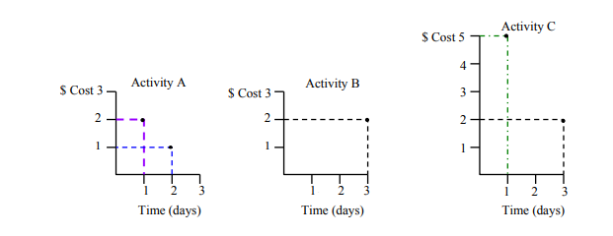
PERT/Cost
Step 2: Obtain alternative time-cost estimates for each activity.

Slide 14
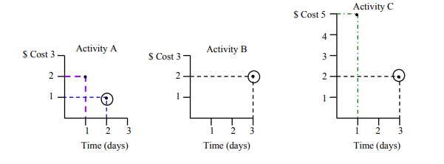
PERT/Cost
Step 3: Select the lowest cost activity for each activity.

Slide 15
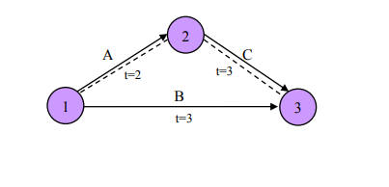
PERT/Cost
Step 4: Calculate critical path and compare with directed completion date.

Slide 16
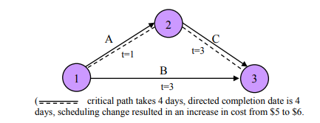
PERT/Cost
Step 5: Adjust critical path to meet directed completion date at lowest possible costs.

Slide 17
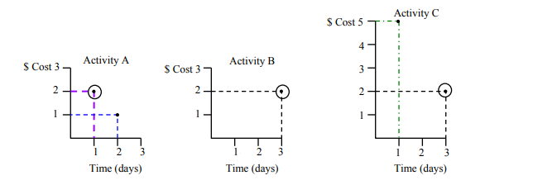
PERT/Cost

Slide 18
PERT/Cost
In the Resource Allocation supplement procedure, one can determine how to accomplish a project by a specified date at minimum cost. The critical path is from event 1 to event 2 and from event 2 to event 3 since it requires 5 days at absolute minimum costs. However, our assigned completion date is 4 days from the beginning. From our activity time-cost charts, one finds that cutting activity A one day doubles its cost. However, since shortening the activity time for activity C would result in an even greater cost increase, we choose to shorten activity A’s time.

Slide 19
Crashing of activity
Cost reduction by crashing of activity
Project crashing involves shortening the expected time taken for a project.
This is primarily done by adding more resources to it.
Crashing in a project is an activity that will shorten the completion time of a project within the optimum cost increase.

Slide 20
Crashing of activity
What are the problems a project may face?
A delay
Lack of quality
A problem with coordination
Mismatch of expectations
A poor plan
Unforeseen circumstances
External factors
Change of scope

Slide 21
Crashing of activity
What Prompts Crashing in Project Management?
If there is a heavy penalty for failing to meet a project completion deadline, then the increased cost of crashing could be justified to an extent.
If there is an external change where a competitor is working on a similar project, the cost of not speeding up the project would lead to the loss of a competitive edge.
In case there is an activity that delays a host of other activities, crashing that activity could bring benefits across the project.

Slide 22
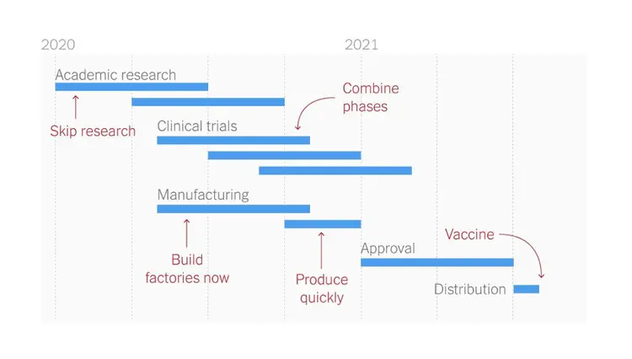
Crashing of activity
An Example of Crashing in Project Management – Covid case

Slide 23
Crashing of activity
While crashing into an activity in your project consider :
Critical Path
Cost and Benefit
Resource Availability
Training Needs

Slide 24
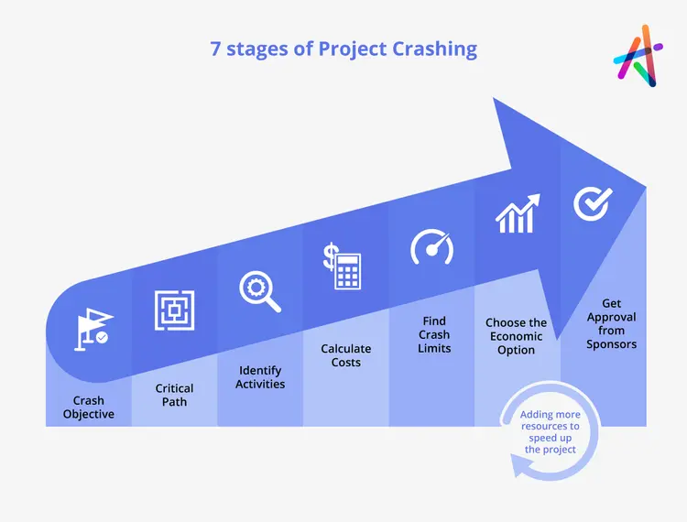
Crashing of activity
Project Crashing Management Stages

Slide 25
Crashing of activity
1. Crash Objective
The first stage of the project crashing is understanding the need for it and the objective in terms of what is to be accomplished. If the scope of the project has been reduced, then there may not be a need to add more resources to speed up the project.
How to use the workforce or what amount of work can be outsourced etc. can be estimated at this stage.

Slide 26
Crashing of activity
2. Critical Path
Each project will have a critical path identified at the beginning. This chain of activities is what needs to be crashed to speed up the project. Crashing an activity outside the critical path does not help in reducing the project time.

Slide 27
Crashing of activity
3. Identify Activities
Not every activity can be crashed. There may be activities that need very specific skills that are not easily transferable. Hence adding resources to that might prove to be counterproductive. The list of activities that can be crashed and are part of the critical path should be the ones in focus.

Slide 28
Crashing of activity
4. Calculate Costs
Crashing involves an increase in cost. This increase in cost will be different for each process. Comparing these costs with each other will help you arrive at a reasonable cost at which some activities can be crashed to sufficiently advance the project completion date.

Slide 29
Crashing of activity
5. Find Crash Limits
Each activity will have a crash limit. This is the point beyond which an action cannot be crashed. Understanding this information will give you an idea of how much the project can potentially be crashed.

Slide 30
Crashing of activity
6. Choose the Economic Option
Once you have an idea of how much each activity can be crashed and the cost associated with it, it becomes easy to identify how many activities to target and to what extent they need to be crashed to meet the objective at the most reasonable cost.

Slide 31
Crashing of activity
7. Get Approval from Sponsors
Once you have identified the most reasonable or most viable crashing plan, then you can convince the key stakeholders of the project and get their approval to implement it.

Slide 32
Resource Scheduling
Resource scheduling is a process used by teams to organize and structure their time, so tasks they need to complete are scheduled based on availability and capability.
It determines the timeline and resources required to complete a project.
Analyze how well resources are being utilized and reassign tasks to people who are not working to their full utilization rates.
Track project estimations and outcomes to make future scheduling easier.

Slide 33
Need for Resource Scheduling
Reduces overallocation: Team leaders can assign people tasks without over (or under) allocating their schedules. In return, team members are constantly working on an optimized schedule
Improves task allocation: It makes it easy to identify who should be working on what and when and helps match people with tasks they're best suited for.
Provides accurate demand forecasts: It gives team leaders a chance to fill gaps before they can derail a project. If you don't have a designer or engineer on your team to complete a specific task, you'll know ahead of time and can reallocate work or bring in extra help!

Slide 34
Types of Resource Scheduling
1. Resource Constraint Scheduling:
Resource-constrained scheduling is a method used to complete a project with limited resources. It involves adjusting projects to align with resource capabilities.
Say you have a project that ideally requires three people to complete, but you only have one person available. This process helps you maximize the use of your available team members or find a way to get the job done without missing the project deadline

Slide 35
Resource Scheduling
2. Time constrained scheduling
Time-constrained scheduling is a method used to manage resources and schedule activities when there are strict deadlines to meet.
For example, your team is working on a preorder website that has to be rolled out in two weeks. Halfway through the project, you realize that the team isn't moving fast enough to meet the deadline. So you hire a freelance developer to help speed things up.

Slide 36
Resource Scheduling
Resource scheduling in 5 steps
Step 1. Break down tasks within a project
The first step to resource scheduling is figuring out what jobs you need to tackle on a project.
Start by looking at the project as a whole and then breaking down each part into individual tasks.

Slide 37
Resource Scheduling
Step 2. Look at your resource capabilities
confirm who is available to take on tasks.
This step goes beyond just looking at who has space on their calendar for a project.
need to ensure people with space on their calendars also have the skills required to complete the work.

Slide 38
Resource Scheduling
Step 3. Schedule tasks to team members based on their availability
assigning tasks to your team based on their availability.
Review past projects like the one you are scheduling to get an idea of how long you should allow each task on your team's calendars.

Slide 39
Resource Scheduling
Step 4. Manage and monitor resources as the project progresses
It's crucial to monitor individual tasks' progress so your project doesn't get knocked off course.
If a team member calls in sick or takes some vacation time, you'll need a plan to reassign their tasks or move their deadlines backward.

Slide 40
Resource Scheduling
Step 5. Track the actual time spent on tasks and activities
Finally, track everything, so you make the project run even smoother.
By tracking how many resources you used on each task and the time it took to complete them, you'll be able to use that data to tighten up your future schedules.
Adding time tracking to your resource scheduling software is the easiest and most effective way. See if a project task is taking your team longer than expected or your resources are being used inefficiently.

Slide 41
Resource Levelling
Resource leveling is a project management technique that involves resolving overallocation or scheduling conflicts to ensure a project can be completed with the available resources.
Resources include the time, materials, or tools needed to complete a project.

Slide 42
Resource Levelling
The purpose of resource leveling is to get the most out of available resources while working within the project’s time, cost, and scope constraints.
Resource leveling can be challenging for project managers as it requires balancing the demand for the same resources across multiple projects.

Slide 43
Resource Levelling
Depending on your team needs, here are possible outcomes:
If the goal is to keep the current project deadline, more resources may need to be made available.
If the goal is to run the project with currently available resources, the deadline of the project may be extended.

Slide 44
Resource Levelling
When to use resource leveling
To optimize your resources
To minimize deficits
To prevent task overloading
To ensure the quality of a project output

Slide 45
Resource Levelling
Example of Obtaining additional resources
The IT team has been responding to a large number of IT requests to deal with a virus that infected company computers. Since the company’s current antivirus software isn’t robust enough to handle the virus, the team decides to invest in new antivirus software so they’re able to fix the computers.

Slide 46
Resource Levelling
Example of Postponing a project end date :
The marketing team is launching a new social media campaign and they’re waiting for approval from the social media manager, who is currently out of the office due to illness. Since the campaign isn’t time-sensitive, they decide to push the launch date back by a few days so the manager has time to review.
Whether you lead a marketing, sales, or IT team, resource leveling can come in handy for resolving resource conflicts. Once you decide on a solution, let the rest of your team know your plan.

